Slide 1
Sentiment Analysis
Team Member:
Anvesh Athmakuri
Ashik Shaik
Bharath Ramagoni
Abhishek Malyala

Slide 2
What is Sentiment Analysis
Sentiment analysis can be defined as a process that automates mining of attitudes, opinions, views and emotions from text, speech, tweets and database sources through Natural Language Processing (NLP).
Sentiment analysis involves classifying opinions in text into categories like "positive" or "negative" or "neutral".

Slide 3
Why is this Important?
It is an important research on understanding and learning public/users opinion which helps in various verticals, such as:
Determine marketing strategy
Improve campaign success
Improve product messaging
Improve customer service
Example:
Customers look upon reviews of products which are available online before they buy them. And for many businesses, the online opinion decides the success or failure of their product.

Slide 4
Sentiment Analysis of Twitter data
Why on Twitter Data?
Twitter is Top and universally well known social media.
Sentiment analysis of twitter data which is helpful to analyze the information in the tweets where opinions are highly unstructured, heterogeneous and are either positive or negative, or neutral in some cases.
Example:
Trump’s New Tax plan
If we do sentiment Analysis on tweets related to this then government or political parties know how the people were responding for the new government policies and it may be useful for taking decisions on implementing new policies further.

Slide 5
Data Set
It is Excel (.csv File) contains 1,578,627 classified tweets, each row is marked as
1 for positive sentiment
0 for negative sentiment.
Source:
URL: http://thinknook.com/twitter-sentiment-analysis-training-corpus-dataset-2012-09-22/
Sample Instances:
ItemID Sentiment SentimentText(Tweet)
1 0 is so sad for my APL friend.
2 1 Going To See Harry Sunday Happiness

Slide 6
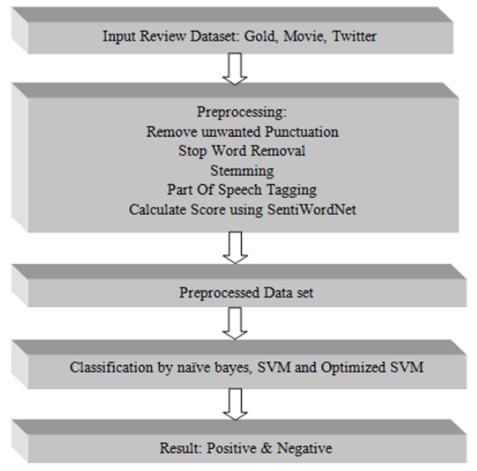
Related Work
The following paper classifies social media text to positive and negative using SVM and naive bayes:

Slide 7
Pre-Processing Steps
Remove unwanted punctuation
Stop Word Removal: Some words used more and more time such words are called stop word.
Stemming : It converts word into its grammatical root form.
eg: teaching -> teach (Remove ‘ing’)
We used Porter Stem in our project.
Extract features from tweets using several feature extraction techniques like Term Frequency, Document frequency vectors
We have taken Tf-Idf (Term Frequency- Inverse Document Frequency)

Slide 8
Term frequency (TF): A frequency of a word in the document.
Inverse Document Frequency(IDF): The occurrence of the word among the documents.
Why TF-Idf?
The tf-idf value increases proportionally to the number of times a word appears in the document, but is offset by the frequency of the word in the corpus

Slide 9
Proposed Approach
Data Collection: existing twitter data set
Data Pre-processing: get the "clean" data and transform it to the format we need
Sentiment Analysis: train a classifier to classify the tweets as: positive, negative.
Create a model for naïve Bayes and SVM , and compare their F-1 scores for processed and unprocessed data.
Naïve Bayes classifier: It is a probabilistic classifiers based on applying Bayes' theorem
SVM: Support Vector Machine (SVM) is a non-probabilistic binary linear classifier

Slide 10
Experiment 1
We select a random 10,000 tweets and split it into 6,000 training tweets and 4,000 tweets for testing
We then train an SVM over the 6,000 tweets. We optimize the SVM by tuning kernel, C and gamma parameter over 10 fold cross validation on training data.
SVM can efficiently perform a non-linear classification using what is called the kernel trick, implicitly mapping their inputs into high-dimensional feature spaces.
• We also train a Multinomial Naive Bayes classifier with the 6,000 training tweets
We finally report the precision, recall and F1-score over the 4,000 test tweets.

Slide 11
In what measures we compare the Classifiers?
1)Time: How much time taken to train the classifier and predict the test instatnces. It says which Classifier is faster.
2)Performance:
Here we considered F1 Score as a measure of Test Accuracy.
The F₁score is the harmonic average of the precision and recall, where an F₁ score reaches its best value at 1 and worst at 0.
F1 score= 1/Recall + 1/Precision
As we taken Tf-IDF vectors as feature vectors for our classifier we considered F1 score as a Accuracy measure to compare which classifier is better.

Slide 12
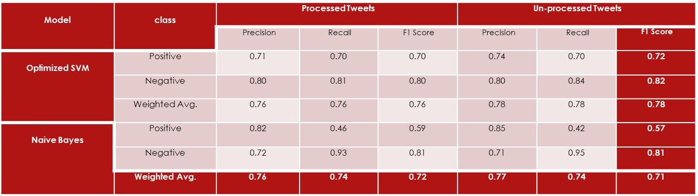
Result 1
From Experiment 1, we observed that Naive Bayes classifier executed faster than SVM classifier.
• With Naive Bayes classifier, The overall performance with unprocessed tweets is slightly better compared to processed tweets
• However, training an SVM with unprocessed tweets yielded better results.
Optimal SVM classifier got better performance (F1 Score) than Naïve Bayes Classifier.
Notes:
An intuition to this can be obtained from the fact that given the short length of tweets, people generally use stopwords such as and, while, before, after and so on.
Thus removal of stopwords makes a lot of difference to the accuracy

Slide 13
Experiment 2
From above experiment we learned that Naive Bayes classifier is faster
We now split considered 50000 random tweets from the data and divided them into 30,000 train and 20,000 test tweets.
We report the results of a Multinomial Naive Bayes classifier trained over the 30,000 tweets, and testing them on 20,000 test tweets

Slide 14
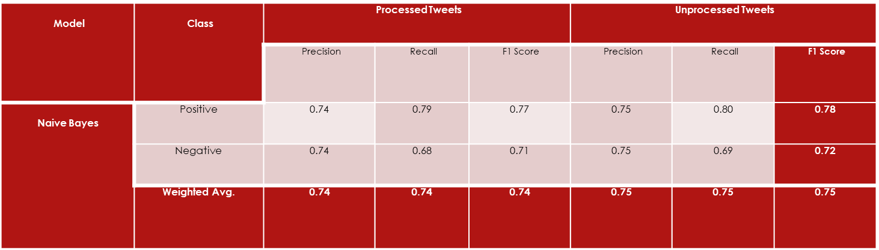
Result 2
• With Naive Bayes classifier, The overall performance with processed tweets is slightly lower compared to unprocessed tweets
• Increasing the training data evidently improved the performance of Naive Bayes classifier.

Slide 15
Challenges in Sentiment Analysis
Domain Dependence:
The same sentence or phrase can have different meanings in different domains.
For Example, the word “unpredictable” is positive in the domain of movies, dramas ,etc, but if the same word is used in the context of a vehicle's steering, then it has a negative opinion
Sarcasm Detection:
Sarcastic sentences express negative opinion about a target using positive words in unique way
Eg: “Nice perfume. You must shower in it.”

Slide 16
Thwarted expressions:
There are some sentences in which only some part of text determines the overall polarity of the document.
Example: “This Movie should be amazing. It sounds like a great plot, the popular actors , and the supporting cast is talented as well”.
In this case, a simple bag-of-words approaches will term it as positive sentiment, but the ultimate sentiment is negative

Slide 17
Explicit Negation of sentiment:
Sentiment can be negated in many ways as opposed to using simple no, not, never, etc. It is difficult to identify such negations .
Example: “It avoids all suspense and predictability found in Hollywood movies.”
Here the words suspense and predictable bear a negative sentiment, the usage of “avoids” negates their respective sentiments

Slide 18
Thank You

